Slide 3
1. About us
Company’s mission:
To provide tailor-made services to our clients;
To make VAT as clear and accessible as possible;
Support our client’s economic activities regardless of their size.
Capabilities:
Six innovative and committed VAT experts fully dedicated to their client’s needs;
Several years of experience of VAT consultancy to serve our client’s interests.
Accreditation:
Proud to be a chartered member of the Institute for Tax Advisors and Accountants (ITAA).

Slide 4
2. Our services
What can we offer ?
Day to day assistance
Assistance related to VAT advice
Assistance on reporting obligations

Slide 5
3. Our sectors of activity
…
And more
Industry
e-Commerce
Services
Retail
Good flow

Slide 6
4. What else can we offer?
Seminars and formations
Webinars
International network
VAT News;
VAT from A to Z;
VAT lessons for HEC;
And more…
The VAT and the ASBL;
The importations;
e-Invoicing;
And more…
Europe;
USA;
Asia;
Africa.

Slide 7
5. The Team
Email : mt@belgianvatadvisors.be
Mobile : +32 477 98 69 98
Email : ct@belgianvatadvisors.be
Mobile : +32 483 24 06 20
Mickael Tatayas
Christelle Thiry
VAT Partner
VAT Director
He has more than 16 years of experience in VAT advisory including multiple years in Big Four firms in Belgium and Luxembourg;
He is specialized in the manufacturing, real estate and healthcare sectors and developed his competence regarding distance selling, fixed establishment and cross-border transactions;
Mickael holds a degree in law from the UCL (University of Louvain), a special degree in tax (Solvay Brussels School – University of Brussels), a special degree in tax in Luxembourg (University of Luxembourg) and a special degree in customs in Belgium (University of Liège).
She has more than seven years of experience in VAT advisory including multiple years in a Big Four firm in Belgium;
She is an expert in consulting and compliance on various topics (e-commerce, VAT chain, VAT audits, fixed establishment, etc.). Currently focusing on digitalization in relation to VAT;
Christelle holds a law degree from the University of Namur, a Master’s degree in business law and a special master’s degree in tax law from the University of Liège.

Slide 8
5. The Team
Email : ab@belgianvatadvisors.be
Mobile : +32 488 76 28 12
Email : eb@belgianvatadvisors.be
Alexandra Boulengier
Emmanuel Brunin
VAT Manager
VAT Senior Consultant
She has more than six years of experience in VAT advisory including four years in a Big Four firm in Luxembourg;
She is an expert in compliance and advisory for international companies specialized in the financial sector due to her experience in Luxembourg and currently specializing in the digitalization of VAT-related matters;
Alexandra holds an accounting and business degree from the EPHEC and has obtained several certificates in Luxembourg Tax law.
He has more than two years of experience in VAT advisory and more than two years at practicing in a notary’s office;
He is specialized in VAT consulting on various topics such as real estate, non-profit organization and VAT audits;
Emmanuel holds a law degree from the University of Namur, a master’s degree in law from UCL (University of Louvain) and a special master’s degree in Tax law from the University of Brussels.

Slide 9
5. The Team
Email : dc@belgianvatadvisors.be
Email : tb@belgianvatadvisors.be
Dorian Christiaens
Thibault Bayet
VAT Consultant
VAT Consultant
He has more than two years of experience in VAT advisory;
He is enhancing his VAT knowledge by providing assistance to national and international companies in their day-to-day needs;
Dorian holds an accounting degree and currently follows a special master’s degree in Tax law to improve his skills.
He has more than two years of experience in VAT advisory;
He is currently developing his knowledge in VAT matters by working in the following areas: VAT compliance obligation, VAT identification, VAT consulting, … in Belgium or internationally and currently develop a project in the football sector;
Thibault holds an accounting degree and a special master’s degree in Tax law after following two years of internship.

Slide 10
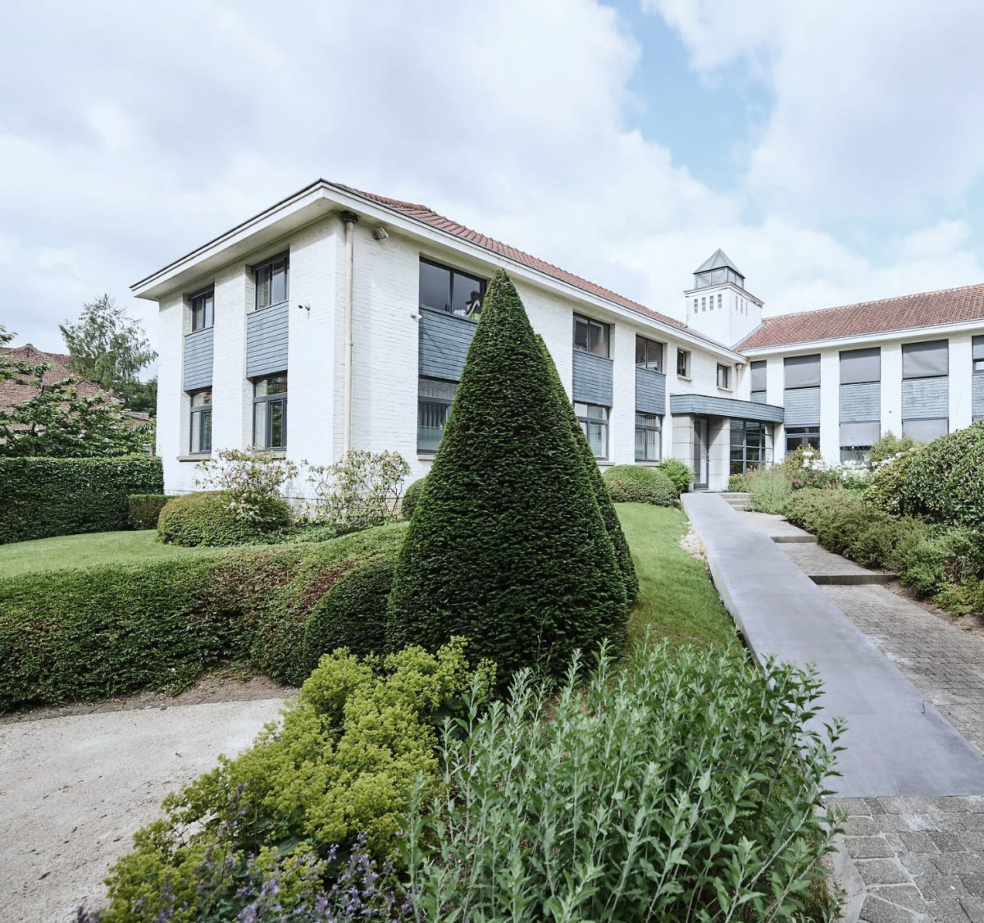
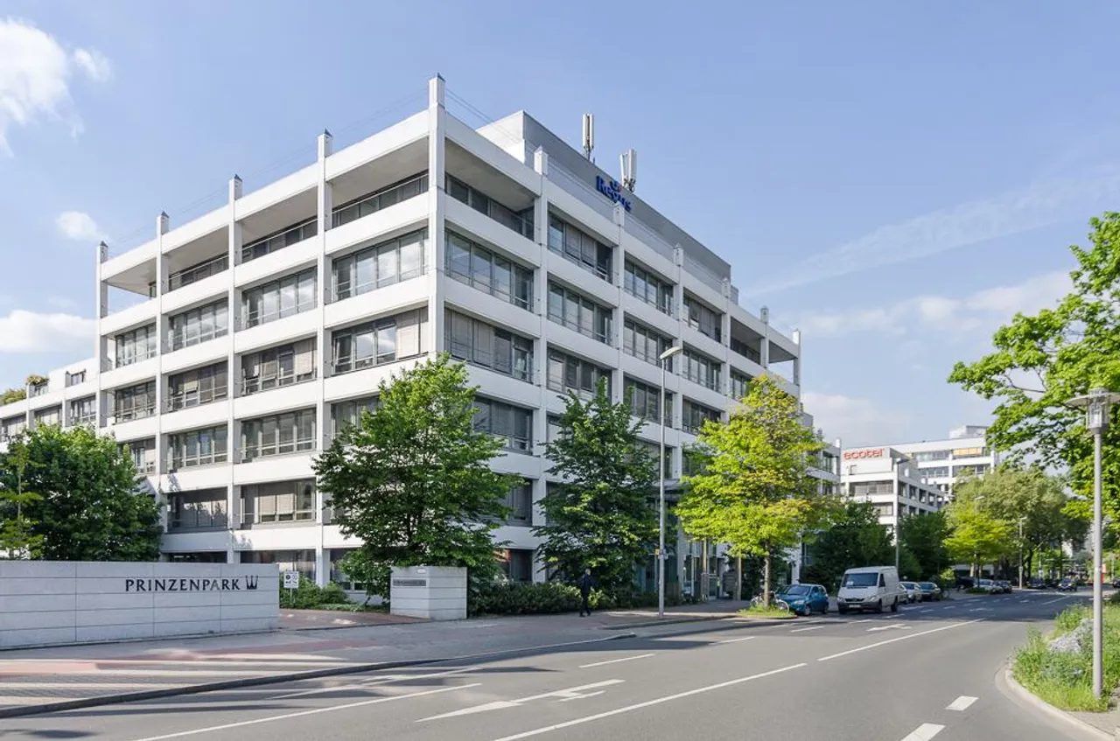
6. Our offices
BVA in Belgium
BVA in Germany
Avenue du Dirigeable 8
1170 Bruxelles
Belgium
T : +32 477 98 69 98
E : info@belgianvatadvisors.be
Alt-Niederkassel40
40547 Dusseldorf
Germany
T : +32 477 98 69 98
E : info@belgianvatadvisors.be

